Slide 1


Applied Bayesian Signal Processing:
POPULATION GROWTH Problem (KITigawa)
IEEE Oceanic Engineering Society (OES)
Applied BSP Short Course
Monterey, CA, USA
Sept 19th 2016

Slide 2
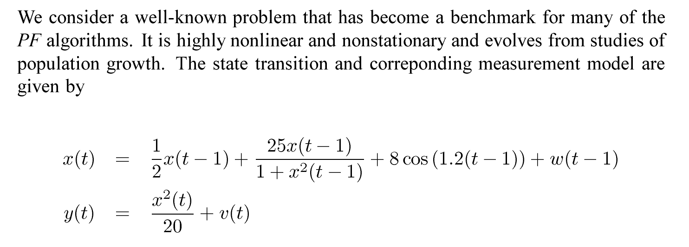
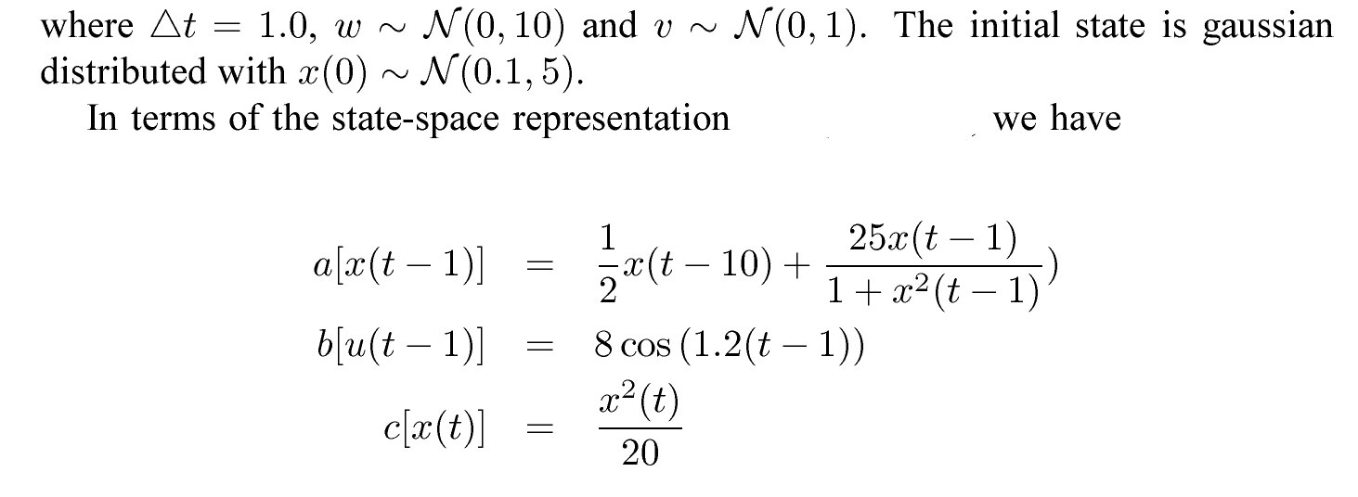
EXAMPLE: Nonlinear, nonstationary non-Gaussian model:

Slide 3
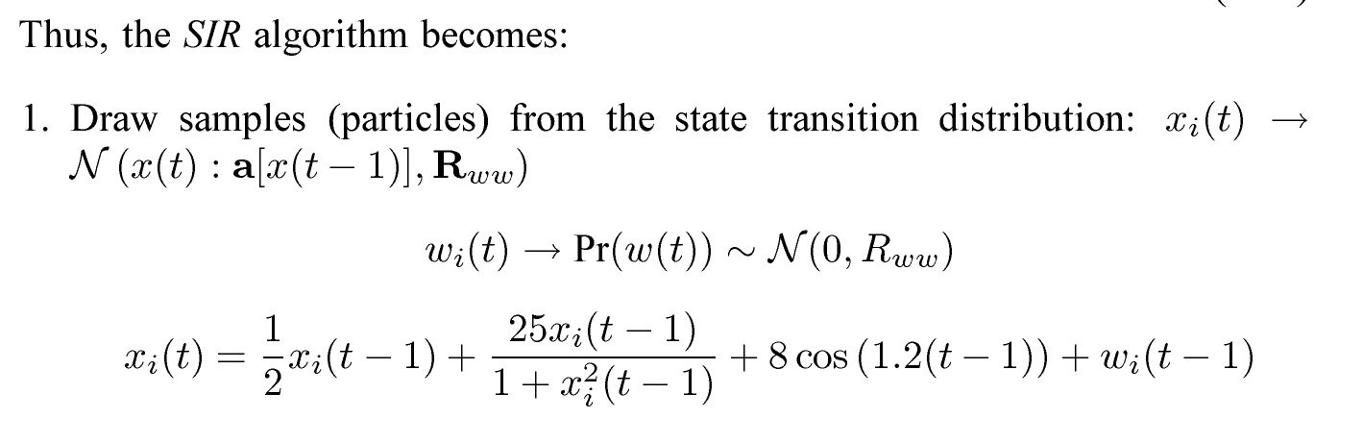
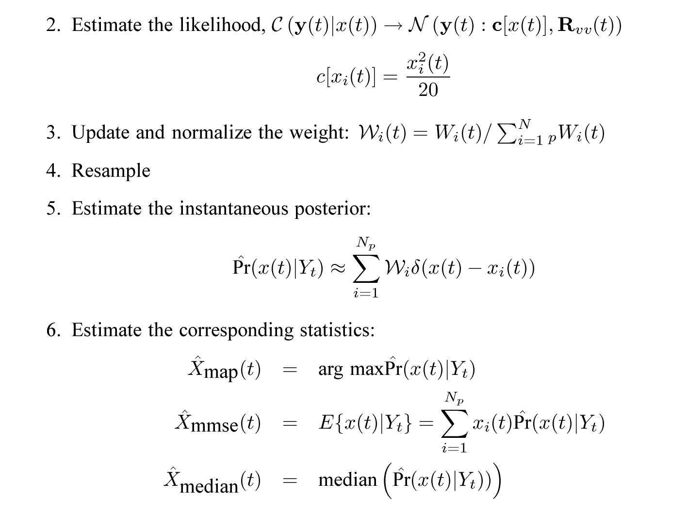
For our problem, the Bootstrap PF algorithm is:

Slide 4
We choose the following design parameters:
No. particles: 250
No. samples: 100
Sampling interval: 1
No. states: 1
No. measurements: 1
Process Noise Covariance: 10
Measurement Noise Cov. : 1
Initial State: 0.1
Initial State Covariance: 5

Slide 5
Bootstrap PF STATE estimation is effective for this problem
20
Simulated State
Mean
15
State
10
5
0
-5
-10
-15
20
Data
Estimated State
15
10
CM
MAP
5
0
-5
-10
KF
DataX
MeanX
-15
CXupdate
KFXupdate
MAPX
-20
0
10
20
30
40
50
60
70
80
90
100
Time(sec)

Slide 6
Bootstrap PF MEASUREMENT prediction estimates are reasonable
Simulated Measurement
Mean
Data
15
10
5
0
0
PF Predicted Measurement
DataY
KF
MeanY
30
KFYpred
CYpred
PFYmap
25
Data
MAP
20
CM
15
10
5
0
-5
0
10
20
30
40
50
60
70
80
90
100
Time(sec)

Slide 7
The particles capture multimodal PDF
Updated PDF ((Pr[x(t)|Y
] )State No. 1
0.07
t
0.06
0.05
0.04
Probability
0.03
0.02
0.01
0
-15.5
-15
-14.5
-14
-13.5
-13
-12.5
-12
-11.5
-11
Xupdate Sample No.68

Slide 8
Particle evolution exposes the underlying multi-modal structure
TIME-STEP: 10
TIME-STEP: 40
TIME-STEP: 60
TIME-STEP: 90
UPDATE PREDICT
UPDATE PREDICT
UPDATE PREDICT
UPDATE PREDICT

Slide 9
A look at the estimated posterior is revealing showing
slices in time
Updated PDF ((Pr[x(t)|Y
] )State No. 1
0.07
t
0.06
0.05
0.04
Probability
0.03
0.02
Updated PDF ((Pr[x(t)|Y
t
] )State No. 1
0.045
0.01
0.04
0
-17.5
-17
-16.5
-16
-15.5
-15
-14.5
Xupdate Sample No.99
0.035
0.03
Probability
0.025
0.02
0.015
0.01
0.005
0
-16
-15
-14
-13
-12
-11
-10
-9
-8
Xupdate Sample No.100

Slide 10
UPDATED & PREDICTED state distributions are quite different:

Slide 11
ANOTHER Realization

Slide 12
Another realization gives interesting results

Slide 13
PF estimates appear to “track” the data
25
DataX
Est. State No. 1
PF Predicted Measurement No. 1
MeanX
25
20
MedXU
DataY
CXupdate
MeanY
MAPX
20
CMYpred
15
PFYpred
10
15
e
5
e
d
d
u
u
t
t
i
i
l
l
0
p
p
m
10
m
A
A
-
-5
Y
-10
5
-15
0
-20
-25
0
10
20
30
40
50
60
70
80
90
100
-5
0
10
20
30
40
50
60
70
80
90
100
Time(sec)
Time(sec)

Slide 14
Classical sanity test passes muster

Slide 15
KLD metrics reveal a mismatch, but …

Slide 16
ENSEMBLE techniques are more telling

Slide 17
25
ENS (100): MAP/CM Est. State No. 1
20
15
10
e
d
5
u
t
i
l
p
m
0
A
e
t
a
t
S
-5
-10
-15
Data
-20
True
CM
-25
MAP
0
10
20
30
40
50
60
70
80
90
100
Time(sec)
25
Measurement Estimation: Ensemble = 100 Measurement No. = 1
Data
Mean
20
YpredEns
YmapEns
15
e
d
u
t
i
l
10
p
m
A
5
0
-5
0
10
20
30
40
50
60
70
80
90
100
Time (sec)

Slide 18
Classical sanity testing over the ensemble implies a reasonable performance

Slide 19
ENSEMBLE PMFs are not good fits as indicated by the Kullback-Leibler divergence

Slide 20
ENSEMBLE PMFs are not good fits as indicated by KLDs but state PMFs are better

Slide 21
The multimodal surface is revealing

Slide 22
% Tom Schon, University of Linkoping, PhD 2006
% (Permission Granted)---MATLAB code
N = 10000; % Number of particles
P0 = 5; % Initial process noise covariance
Q = 10; % Process noise covariance
R = 1; % Measurement noise covariance
pe = inline('1/(2*pi*1)^(1/2)*exp(-(x.^2)/(2*1))');
f = inline('x./2+25*x./(1+x.^2)+8*cos(1.2*t)','x','t');
h = inline('(x.^2)/20');
x(1) = sqrt(P0)*randn(1); % Initial state value
y(1) = feval(h,x(1)) + sqrt(R)*randn(1);
for t = 2:100 % Simulate the system
x(t) = feval(f,x(t-1),t) + sqrt(Q)*randn(1);
y(t) = feval(h,x(t)) + sqrt(R)*randn(1);
end
xTrue = x;
yTrue=y;
xhat = SIR(y,f,h,pe,Q,P0,N); % Estimated state
yhat = feval(h,xhat); % Estimated measurement
function [xhat] = SIR(y,f,h,pe,Q,P0,N)
x = sqrt(P0)*randn(1,N); % STEP 1, Initialize the particles
for t = 1:100
e = repmat(y(t),1,N) -h(x); % STEP 2, Calculate weights
q = feval(pe,e); % The likelihood function
q = q/sum(q); % Normalize the importance weights
ind = resampling(q); % STEP 3, Measurement update
x = x(:,ind); % The new particles
xhat(t) = mean(x); % Compute the estimate-conditional mean
x = feval(f,x,t)+sqrt(Q)*randn(1,N); % STEP 4, Time update
end
function [i] = resampling(q)
P = cumsum(q); N = length(q);
u = cumprod(rand(1,N).^(1./(N:-1:1)));
ut = fliplr(u); k = 1; i = zeros(1,N);
for j = 1:N
while(P(k)<ut(j))
k=k+1;
end;
i(j) = k;
end;

